Slide 1
ANNAMALAI UNIVERSITY
DEPARTMENT OF COMMERCE
WELCOME PARTICIPANTS

Slide 2
A PRESENTATION BY
PROF. D. ILANGOVAN, HD in Commerce
ANNAMALAI UNIVERSITY ON
CONCEPTS
IN
COMMERCE

Slide 3
BANKING

Slide 4
General currency vs
Crypto/DIGITAL currency
Currency is a generally accepted form of money, including coins and paper notes, which is issued by a government and circulated within an economy. Used as a medium of exchange for goods and services, currency is the basis for trade. Bank Note is one which is issued by the central bank of a country.
A Digital currency is one in which encryption techniques are used to regulate the generation of units of currency and verify the transfer of funds, operating independently of a central bank.

Slide 5
Virtual currency
Virtual currency can be defined as an electronic representation of monetary value that may be issued, managed and controlled by private issuers, developers, or the founding organization.
Such virtual currencies are often represented in terms of tokens and may remain unregulated without a legal tender.

Slide 6
Demonetization and Remonetisation
Demonetization is another term in Economics, which is the act of stripping out a currency unit of its status as legal tender. Demonetization is necessary whenever there is a change of national currency.
So, remonetisation refers to introducing a legal tender AFRESH again which had been previously demonetized.

Slide 7
Artificial Intelligence in Banks
Artificial Intelligence is the intelligence which is shown by machines and not humans. ...
Cognitive computing,
Chat bots,
Personal Assistant,
Machine Learning are all peripherals of AI used in the finance industry extensively nowadays.

Slide 8
SWIFT, IFSC, BCSBI, CRISIL
Society for Worldwide Interbank Financial Telecommunications. Global communication network that facilitates 24-hour secure international exchange of payment instructions between banks, central banks, multinational corporations, and major securities firms
IFSC stands for Indian Financial System Code. It's an 11-digit code written in an alphanumeric format, and it identifies the branches in the National Electronic Funds Transfer (NEFT) network
BCSBI is an independent and autonomous institution to monitor and ensure that the Banking Codes and Standards adopted by the banks are adhered to in true CRISIL (formerly Credit Rating Information Services of India Limited) is a global analytical company providing ratings, research, and risk and policy advisory services.
CRISIL's majority shareholder is Standard & Poor's, a division of McGraw Hill Financial and provider of financial market intelligence

Slide 9
CRR&SLR
CRR and SLR are two different ratios.
CRR is a cash reserve ratio and SLR is statutory liquidity ratio.
Under CRR a certain percentage of the total bank deposits has to be kept in the current account with RBI which means banks do not have access to that EXCESS amount for any economic activity or commercial activity.
Interest Rate is a rate at which money can be lent as advised by the RBI
Discount Rate is a rate at which all forms of financial instruments are realized for further use

Slide 10
Block Chain Technology
[leading to bit coin]
A blockchain is a decentralized, distributed and public digital ledger that is used to record transactions across many computers so that any involved record cannot be altered retroactively, without the alteration of all subsequent blocks

Slide 11
Robotics in Banking
Robotics in banking is defined as the use of robotic process automation software like UiPath, Automation Anywhere, or Blue Prism, to install desktop and end user device level software robots, or an artificial intelligence workforce, or assistants, to help process banking work that is repetitive in nature.

Slide 12
Prudential Norms of Asset & Classification
"Prudential norms" are definitionally the guidelines and general norms issued by the regulating bank (the central bank) of the country for the proper and accountable functioning of bank and bank-like establishments. In other words, the norms are the practices that all banks are expected to follow.

Slide 13
FINANCIAL MANAGEMENT

Slide 14
Cost of Capital
Cost of capital refers to the opportunity cost of making a specific investment. It is the rate of return that could have been earned by putting the same money into a different investment with equal risk.
Thus, the cost of capital is the rate of return required to persuade the investor to make a given investment.

Slide 15
Cash Flow Analysis
An examination of a company's cash inflows and outflows during a specific period.
The analysis begins with a starting balance and generates an ending balance after accounting for all cash receipts and paid expenses during the period.
The cash flow analysis is often used for financial reporting purposes.

Slide 16
Risk and Return
Higher risk is associated with greater probability of higher return and lower risk with a greater probability of smaller return.
This trade off which an investor faces between risk and return while considering investment decisions is called the risk return trade

Slide 17
Changing Role of Financial Manager
Financial managers perform data analysis and advise senior managers on profit -maximizing ideas.
The role of the financial manager, particularly in business, is changing in response to technological advances that have significantly reduced the amount of time it takes to produce financial reports

Slide 18
Capital Structure
In finance, particularly corporate finance, capital structure is the way a CORPORATE UNDERTAKING FINANCES ITS ASSETS through some combination of equity, debt, or hybrid securities.

Slide 19
COOPERATIVE MANAGEMENT

Slide 20
Co-operative Society
A cooperative society (also known as co-operative, co-op, or coop) is "an autonomous association of persons united voluntarily to meet their common economic, social, and cultural needs and aspirations through a jointly-owned and democratically-controlled enterprise"

Slide 21
Co-operative Accounting and Auditing
Cooperative audit is a close examination of financial transactions, maintenance of books of. accounts, documents and other records of a cooperative business and includes an inquiry into the affairs of the society in accordance to the State cooperative Society Act and Rules and Regulations.

Slide 22
Credit and Non Credit Cooperatives
A co operative society is registered under Co operative societies act of state govt or Multi State Cooperative Society act of central govt.
They can do business with members only.
They can not use word Bank in name. They can not issue check book.
Coop banks are regulated by RBI, whereas societies are not.
Those societies which serve money lending are called Credit and economic activities are called Non-credit cooperatives.

Slide 23
Membership and General Body
The cooperative membership is voluntary on the part of a mentally sound person eligible for entering into contract in India without any criminal history in the last three years either male or female or third gender.
The General body refers to the association of all such members who run the cooperative society for their own economic benefit as per the by-law of the same society.

Slide 24
ORGANISATIONAL BEHAVIOUR

Slide 25
Work Ethics
Work ethic is a belief that hard work and diligence have a moral benefit and an inherent ability, virtue or value to strengthen character and individual abilities.

Slide 26
Stress Management
Stress management is a wide spectrum of techniques and psychotherapies aimed at controlling a person's level of stress, especially chronic stress, usually for the purpose of improving everyday functioning.

Slide 27
Work Life Balance
Work–life balance is the term used to describe the balance that an individual needs between time allocated for work and other aspects of life. Areas of life other than work–life can be, but not limited to personal interests, family and social or leisure activities.

Slide 28
Emotional Intelligence
Emotional intelligence refers to the capability of a person to manage and control his or her emotions and possess the ability to control the emotions of others as well.
In other words, they can influence the emotions of other people also

Slide 29
Organisational Effectiveness
Organizational effectiveness is the concept of how effective an organization is in achieving the outcomes the organization intends to produce. Organizational Effectiveness groups in organizations directly concern themselves with several key areas

Slide 30
Group Dynamics
Group dynamics is a system of behaviors and psychological processes occurring within a social group, or between social groups from within an organisation or between various orgnaisations.

Slide 31
Organisational Commitment
Organisational commitment is the bond employees experience with their organisation. Broadly speaking, employees who are committed to their organisation generally feel a connection with their organisation, feel that they fit in and, feel they understand the goals of the organisation.

Slide 32
INTERNATIONAL TRADE

Slide 33
Logistics
Logistics is generally the detailed organization and implementation of a complex operation. In a general business sense, logistics is the management of the flow of things between the point of origin and the point of consumption in order to meet requirements of customers or corporations.

Slide 34
Negative List of Exports
The prohibited items are not permitted to be exported. An export licence will not be given in the normal course for goods in the prohibited category.
For example, No export of rough diamond shall be permitted unless accompanied by Kimberley Process (KP) Certificate as specified by Gem & Jewellery EPC (GJEPC).

Slide 35
Export Processing Zone (EPZ/EOU) Export Oriented Units
The EOU scheme is complementary to the scheme for Free Trade Zone, Export Processing Zone.
Units that are undertaking to export their entire production of goods are allowed to setup as a EOU.

Slide 36
Export House vs Trade house
Export House is defined as a registered exporter holding a valid Export House Certificate issued by the Director general of Foreign Trade in India.
Trading House-A trading house may be an exporter or an importer importer and also may be a trader that purchases and sells products for other businesses.

Slide 37
Dumping
Dumping is a term used in the context of international trade.
It happens when a country or company limits its exports of a product at a price that is lower in the foreign importing market than the price in the exporter's domestic market.

Slide 38
EEFC Accounts
Exchange Earners' Foreign Currency Account (EEFC) is an account maintained in foreign currency with an authorised dealer i.e. a bank dealing in foreign exchange.
No interest is payable on EEFC accounts.
Up to 100% foreign exchange earnings can be credited to the EEFC account.

Slide 39
FINANCIAL MARKETS AND SERVICES

Slide 40
Capital Markets
A capital market is a financial market in which long-term debt or equity-backed securities are bought and sold.
Capital markets channel the wealth of savers to those who can put it to long-term productive use, such as companies or governments making long-term investments.

Slide 41
Non Banking Finance Companies
A Non-Banking Financial Company (NBFC) is a company registered under the Companies Act, 2013 engaged in the business of loans and advances, acquisition of shares/stocks/bonds/debentures/securities issued by Government or local authority or other marketable securities AND may be involved in leasing, hire-purchase or insurance

Slide 42
RTGS,NEFT
National Electronic Fund Transfer (NEFT) and Real Time Gross Settlement (RTGS) allow individuals, companies and firms to transfer funds from one bank to another.
You can check the RBI website for a list of NEFT and RTGS-enabled branches of commercial banks

Slide 43
Blue Chip Stocks
A blue-chip stock is the stock of a large, well-established and financially sound company that has operated for many years.
A blue-chip stock typically has a market capitalization in billions, is generally the market leader or one among the top three companies in its sector, and is more often than not a household name.

Slide 44
UPI
Unified Payment Interface (UPI) is a single-window mobile payment system developed by the National Payments Corporation of India (NPCI).
It eliminates the need to enter bank details or other sensitive information each time a customer initiates a transaction.

Slide 45
Bank-Assurance
Bancassurance is a relationship between a bank and an insurance company that is aimed at offering insurance products or insurance benefits to the bank's customers.
In this partnership, bank staff and tellers become the point of sale and point of contact for the customer.

Slide 46
ENTREPRENEURIAL DEVELOPMENT

Slide 47
Entrepreneur VS. Manager
Difference between Entrepreneur and Manager is their role in the organization.
Entrepreneur is the owner of the company whereas Manager is the employee of the company.
Entrepreneur is a risk taker, they take financial risk for their enterprise.
Manager works for salary and does not take any risks.

Slide 48
Entrepreneur as a Risk-Bearer
An entrepreneur is an agent who buys factors of production at certain prices in order to combine them into a product with a view to selling it at uncertain prices in the future.
Uncertainty is defined as a risk, which cannot be insured against and is incalculable.

Slide 49
ENTREPRENEUER VS INTRAPRENEUR
Entrepreneur is one who starts own enterprise with the support of a few employees and markets the products with or without the support of some distributors.
Intrapreneur is one who starts his business by his own family and markets the product through his own kith and kin and obviously does not employ any one for salary.

Slide 50
TRAITS
Those essential characters found in the enterprising entrepreneurs who are bound to succeed in their attempt are termed as the TRAITS.

Slide 51
MARKETING

Slide 52
Customer-Consumer
A customer buys products regularly from the same business houses, while a consumer uses those products for personal ends. You can actually be both a customer and a consumer in a business transaction.

Slide 53
E-Marketing, E-Retailing, E-Commerce
In E-commerce buying and selling of products or services is conducted over electronic systems such as the Internet and other computer networks.
E-Marketing uses the internet to deliver promotional marketing messages to consumers. It includes email marketing, search engine marketing, social media marketing
E-Retailing is an activity through which a seller disposes the sales activity in small quantities ELECTRONICALLY by himself/herself or others/distributors.

Slide 54
Product Line Product Mix Product Diversification
A product line is a group of related products under a single brand sold by the same company
A product mix refers to the mixture of various groups of product lines from the same company
The evolution of product features of a product line or mix is called product diversification

Slide 55
Advertisement, Publicity, Sales Promotion
The following are the major differences between advertising and promotion: ...Advertising is a part of the promotion. Therefore, it can be said that advertising is also an act of promoting the product. Advertising is done to build brand image and increase sales, whereas Promotion is used to push short-term sales.
Publicity refers to the marketing endevour that enable to reach out the target customers or new customers through temporary but attractive offers made to publicise a product or a brand

Slide 56
Marketing Information System
A marketing information system is a management information system designed to support marketing decision making.
Jobber defines it as a "system in which marketing data is formally gathered, stored, analysed and distributed to managers in accordance with their informational needs on a regular basis

Slide 57
Purchase order vs Sales order
Purchase order is a document used for ordering goods by a dealer or retailer or a customer. It refers to the details as prepared by the buyer is sent to the supplier
Sales order is a document used for confirmation of sale which is issued by the supplier to its buyer before delivery

Slide 58
Personal Selling vs. Salesmanship
Personal selling is basically the oral/face to face conversation between a sales representatives and a prospective buyer for the purpose of closing a deal.
Salesmanship is the process of persuading a person to buy goods or services.

Slide 59
DIRECT & INDIRECT TAXATION

Slide 60
Deductions under section 80
Section 80C. Investments.
Section 80CCC. Insurance Premium.
Section 80CCD. Pension Contribution.
Section 80TTA. Interest on Savings Account.
Section 80GG. House Rent Paid.
Section 80E. Interest on Education Loan.
Section 80EE. Interest on Home Loan.
Section 80CCG. RGESS

Slide 61
GST
Goods and Services Tax (GST) is an indirect tax (or consumption tax) levied in India on the supply of goods and services.
GST is levied at every step in the production process, but is meant to be refunded to all parties in the various stages of production other than the final consumer

Slide 62
Input Tax Credit
Input Tax Credit or ITC is the tax that a business pays on a purchase and that it can use to reduce its tax liability when it makes a sale.
In other words, business houses can reduce their tax liability by claiming credit to the extent of GST paid on purchases.

Slide 63
Exemption u/s10 of IT Act
10(10) Gratuity.
10(10AA) Leave encashment
10(10B) Retrenchment Compensation
10(10C) Compensation for voluntary retirement
10(10CC) Tax on non-monetary perquisites paid by the employer
10(11) Payments received from a provident fund
10(12) Accumulated balance in a recognized provident fund
10(13A) House rent allowance

Slide 64
Clubbing of Income
Clubbing of income means including the income of any other person in Assessee's total income.
Then, such transferred income [of a wife] is added and taxed as total income [of husband only and not his wife].
The clubbing provisions are applicable even if there is no intention to reduce tax liability.

Slide 65
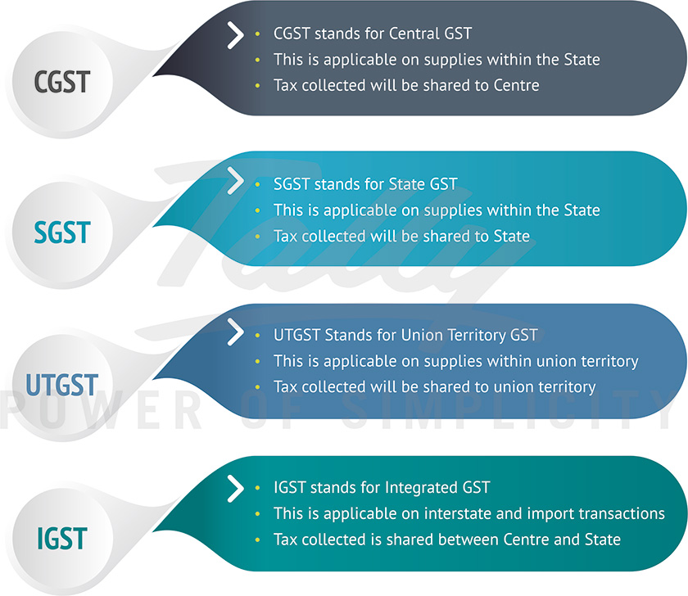
VARIOUS TYPES OF G.S.T

Slide 66
Set Off and Carry Forward of Losses
After making the appropriate and permissible intra-head and inter-head adjustments, there could still be unadjusted losses. These unadjusted losses can be CARRIED FORWARD to future years for adjustments against income of these years.
SET OFF of losses means adjusting the losses against the profit/income of that particular year. Losses that are not set off against income in the same year, can be carried forward to the subsequent years for set off against income of those years

Slide 67
THANK YOU ALL

